Slide 1
PERFORMANCE
APPRAISAL
PORTAL

Slide 2
BATCH NUMBER - 8
TEAM MEMBERS:
RAHUL PRASANTH D (2020506070)
PRAVEEIN S (2020506067)
DEEPAK ATHIPAN A M B (2020506021)
SUBHA DHARSHINI M (2020506095)

Slide 3
TABLE OF CONTENTS
01
02
03
04
OBJECTIVES
PROPOSED SYSTEM
ARCHITECTURE
MODULES
05
06
07
BENEFITS
OUTPUT
REFERENCES

Slide 4
01
OBJECTIVE

Slide 5
OBJECTIVE
The objective of the project is to create a software tool that helps managers assess their candidates’ job performance in a more efficient and accurate way. The tool will automate the data collection process, generate detailed reports, and provide insights into employee performance trends. The goal is to make the performance evaluation process fairer, more consistent, and more objective, which will help improve employee engagement, motivation, and job satisfaction, leading to better outcomes.

Slide 6
02
PROPOSED SYSTEM

Slide 7
PROPOSED SYSTEM
User Interface:
The system would have a user-friendly interface that allows employees to easily access and complete performance evaluations.
The interface would also allow admin to view and evaluate candidate performance.
Performance Evaluation:
This enables the managers to assess their performance with various data
3. Customization:
Customization options would include the ability to set performance goals, adjust evaluation criteria, and choose from various reporting templates.
4. Security:
The system would be secure and protect employee data.
Access to the system would be restricted to authorized persons only.

Slide 8
03
ARCHITECTURE

Slide 9
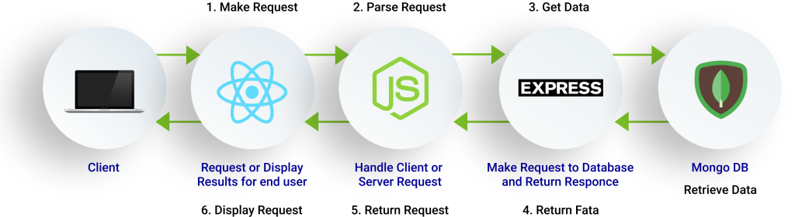
ARCHITECTURE

Slide 10
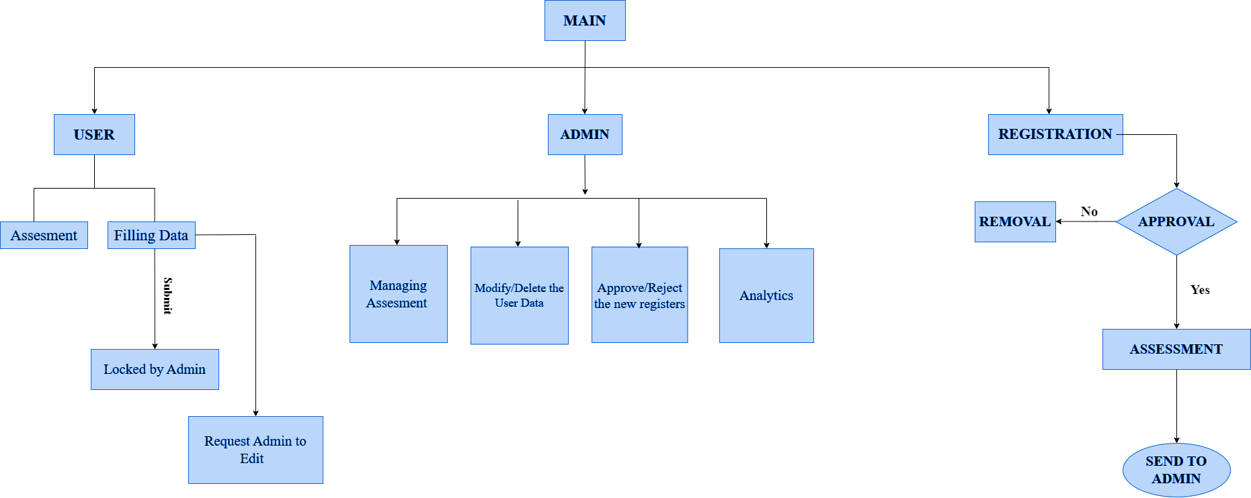
FLOWCHART

Slide 11
04
MODULES

Slide 12
MODULES
Admin
Home page
Candidate Page
ASSESS
1
2
3
4

Slide 13
ADMIN PAGE
There is separate portal for admins who organises this performance appraisal program.
Things that admin can manage:
Candidate’s details
Candidate verification and approval
Assessment for performance analysis
Test results

Slide 14
HOME PAGE
This portal will the be landing page for the site.
This contains:
The details about this site
Login option for admin
Signup and login option for candidates
SignUp and registration status check
Assessment portal

Slide 15
CANDIDATE PAGE
Candidates are the persons who are going to appear for performance analysis and get analysed by their performance in the assessment and the work done by them throughout the academic year.
Things that candidate page can do:
Take up their assessment
Check results
Able to manage their data

Slide 16
ASSESSMENT WINDOW
It consists of both choice based questions and descriptive question to monitor the performance. The evaluation is done by the admin for descriptive type answers and the Choice based questions will be evaluated automatically.
This window consists of:
Timer
Questions with navigation
Users can take the assessment only once.

Slide 17
05
BENEFITS

Slide 18
BENEFITS
Improved communication:
Performance appraisals provide an opportunity for managers and employees to have a constructive dialogue about their performance and goals. This can improve communication and collaboration within the organization.
Provides feedback to employees:
Performance appraisal provides employees with feedback on their performance, including their strengths and weaknesses. This feedback can help employees identify areas where they need to improve and develop their skills.
Helps with decision-making:
Performance appraisal can provide managers with the information they need to make important decisions about promotions, transfers, and other personnel-related matters.

Slide 19
06
OUTPUT

Slide 20
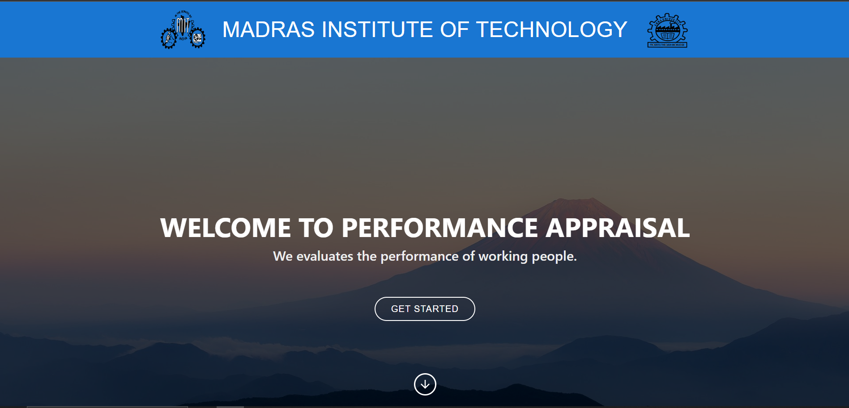
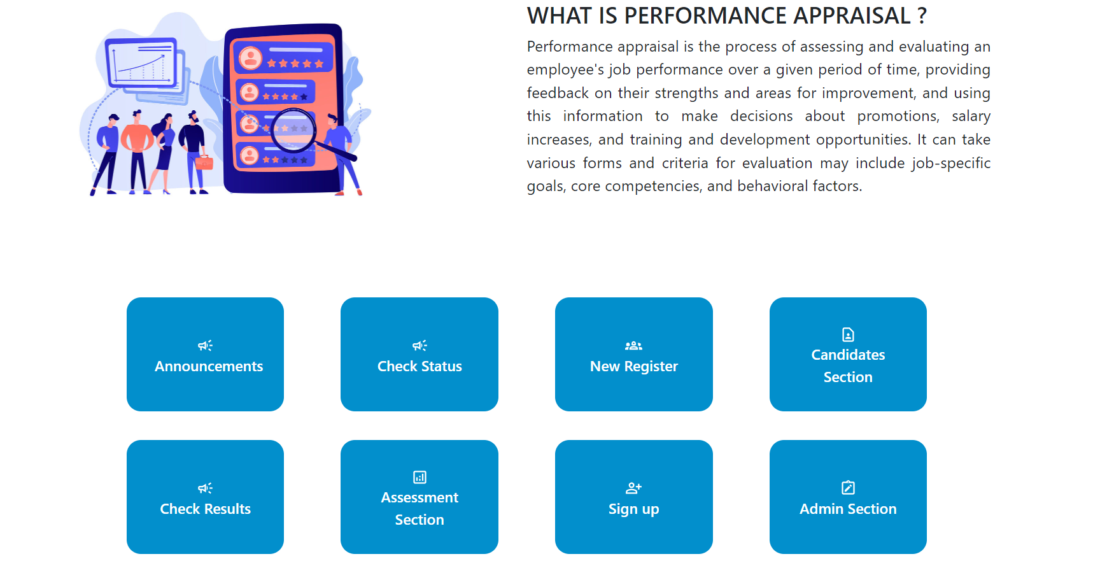
LANDING PAGE

Slide 21
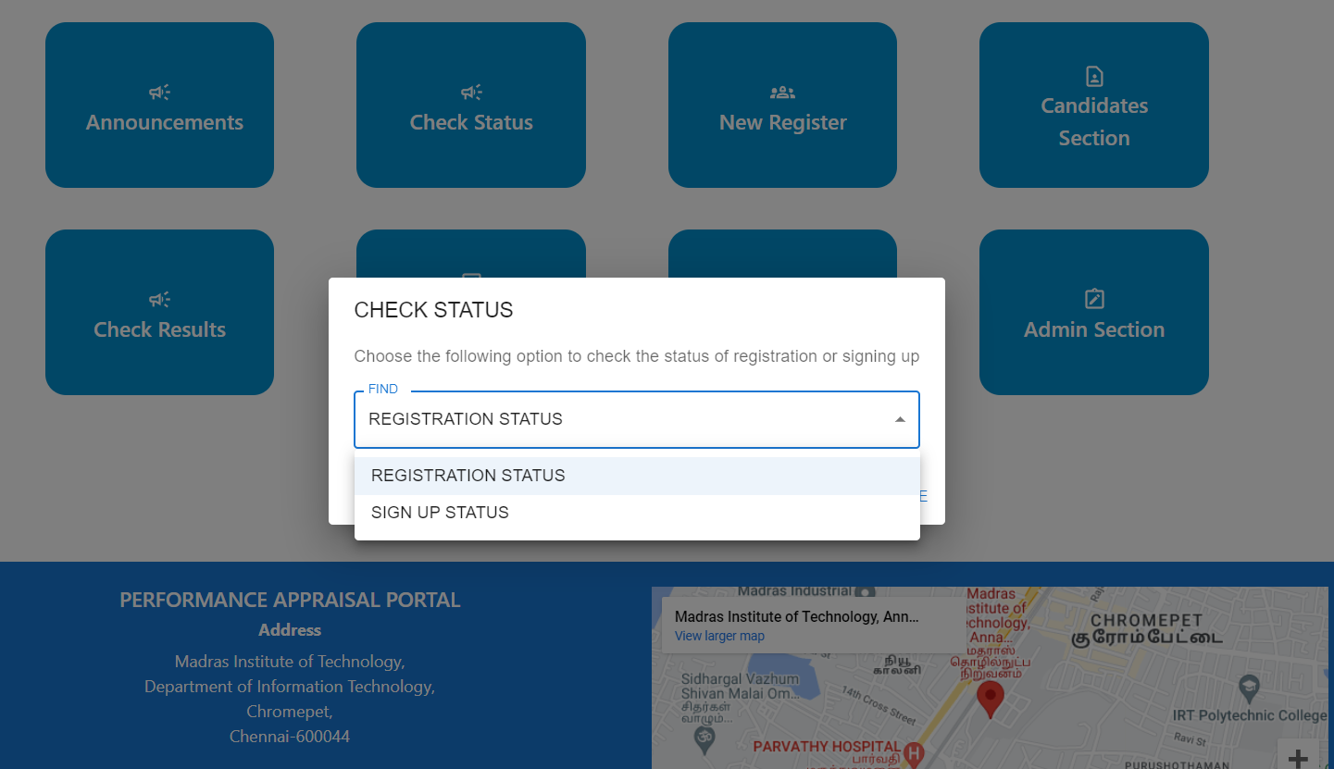
STATUS CHECK

Slide 22
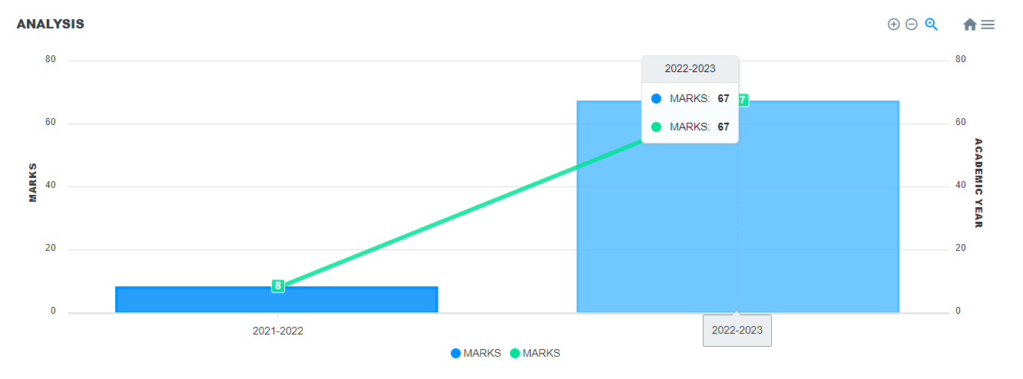
ANALYSIS

Slide 23
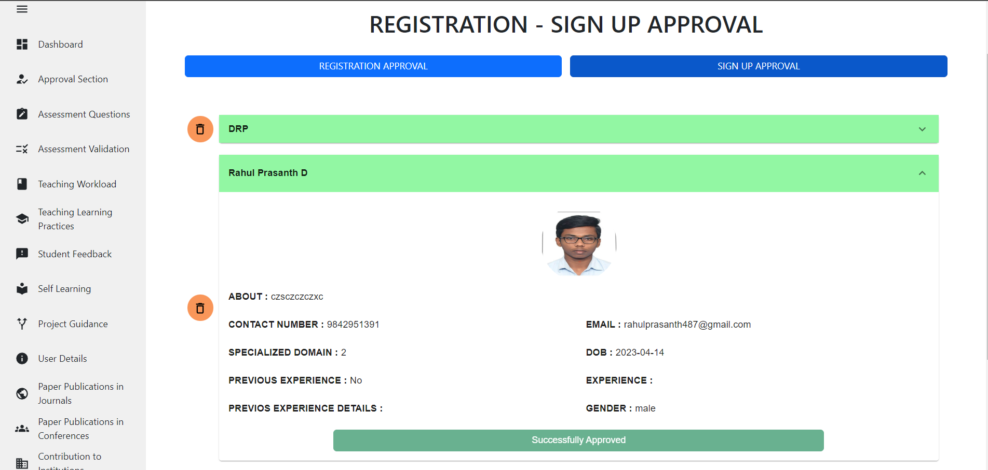
STATUS APPROVAL

Slide 24
REFERENCES
[1] REACT DOCUMENTATION
https://reactjs.org/tutorial/tutorial.html
[2] MONGO DOCUMENTATION
https://www.mongodb.com/docs/compass/current/?_ga=2.194733419.758586910.1678201738-1158236886.1678201738
[3] NODE-EXPRESS-MONGO
https://www.w3schools.com/nodejs/nodejs_mongodb.asp

Slide 25
THANK YOU

